Slide 1

PowerPoint Lectures for
Principles of Economics, 9e
By
Karl E. Case,
Ray C. Fair &
Sharon M. Oster
; ;
<number> of 36

Slide 2

<number> of 36

Slide 3
Input Demand: The Labor
and Land Markets
Prepared by:
Fernando & Yvonn Quijano

Slide 4


Input Demand: The Labor
and Land Markets
PART II THE MARKET SYSTEM
Choices Made by Households and Firms
10
CHAPTER OUTLINE
Input Markets: Basic Concepts
Demand for Inputs: A Derived Demand
Inputs: Complementary and Substitutable
Diminishing Returns
Marginal Revenue Product
Labor Markets
A Firm Using Only One Variable Factor of Production: Labor
A Firm Employing Two Variable Factors of Production in the Short and Long Run
Many Labor Markets
Land Markets
Rent and the Value of Output Produced on Land
The Firm’s Profit-Maximizing Condition in Input Markets
Input Demand Curves
Shifts in Factor Demand Curves
Resource Allocation and the Mix of Output in
Competitive Markets
The Distribution of Income
Looking Ahead
<number> of 36

Slide 5
Input Markets: Basic Concepts
Demand for Inputs: A Derived Demand
derived demand The demand for resources (inputs) that is dependent on the demand for the outputs those resources can be used to produce.
productivity of an input The amount of output produced per unit of that input.
Inputs are demanded by a firm if and only if households demand the good or service produced by that firm.
<number> of 36

Slide 6
Input Markets: Basic Concepts
Inputs: Complementary and Substitutable
Inputs can be complementary or substitutable. Two inputs used together may enhance, or complement, each other.
Diminishing Returns
marginal product of labor (MP_{L}) The additional output produced by 1 additional unit of labor.
<number> of 36

Slide 7

When two inputs are used together, we say that the inputs are:
a. Substitutable.
b. Complementary.
c. Highly productive.
d. Homogeneous.
e. Dependent of the demand for the output they produce.
<number> of 36

Slide 8
When two inputs are used together, we say that the inputs are:
a. Substitutable.
b. Complementary.
c. Highly productive.
d. Homogeneous.
e. Dependent of the demand for the output they produce.
<number> of 36

Slide 9
Input Markets: Basic Concepts
Diminishing Returns
TABLE 10.1 Marginal Revenue Product per Hour of Labor in Sandwich Production (One Grill)
(1) Total Labor Units (Employees) |  | (2) Total Product (Sandwiches per Hour) |  |  | (3) Marginal Product Of Labor (MP_{L}) (Sandwiches per Hour) |  |  | (4) Price (P_{X}) (Value Added per Sandwich)ª |  |  | (5) Marginal Revenue Product (MP_{L} X P_{X}) (per Hour)
0 |  |  | 0 |  |  | − |  |  | − |  |  | −
1 |  |  | 10 |  |  | 10 |  | $ | 0.50 |  | $ | 5.00
2 |  |  | 25 |  |  | 15 |  |  | 0.50 |  |  | 0.50
3 |  |  | 35 |  |  | 10 |  |  | 0.50 |  |  | 0.50
4 |  |  | 40 |  |  | 5 |  |  | 0.50 |  |  | 0.50
5 |  |  | 42 |  |  | 2 |  |  | 0.50 |  |  | 0.50
6 |  |  | 42 |  |  | 0 |  |  | 0.50 |  |  | 0.50
ªThe “price” is essentially profit per sandwich; see discussion in text.
<number> of 36

Slide 10
Input Markets: Basic Concepts
Marginal Revenue Product
marginal revenue product (MRP) The additional revenue a firm earns by employing 1 additional unit of input, ceteris paribus.
MRP_{L} = MP_{L} x P_{X}
<number> of 36

Slide 11

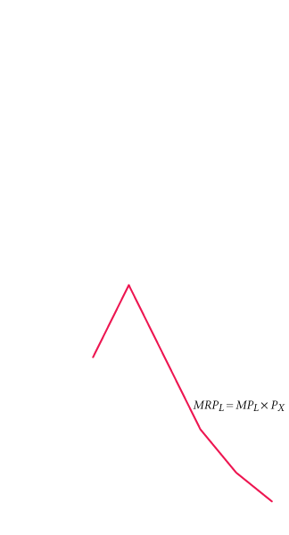
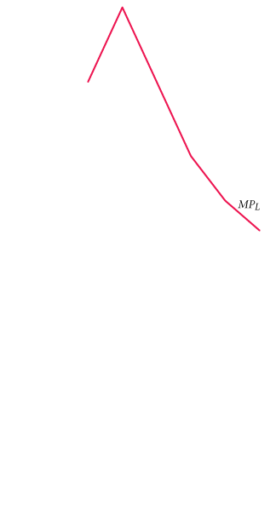
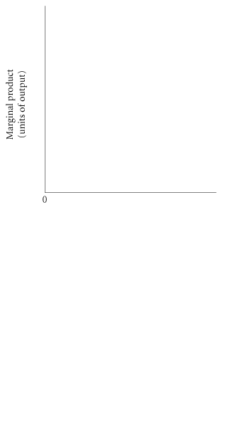
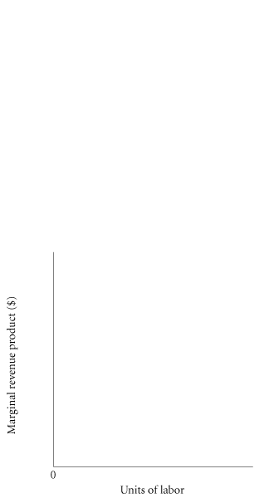



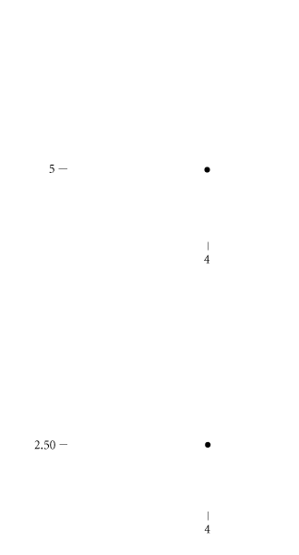
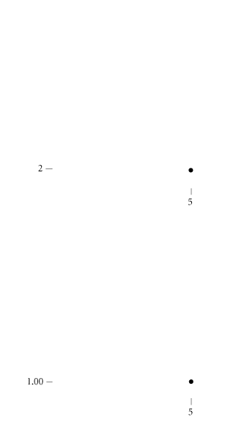

Input Markets: Basic Concepts
Marginal Revenue Product
④ FIGURE 10.1 Deriving a Marginal Revenue Product Curve
from Marginal Product
The marginal revenue product of labor is the price of output, P_{X}, times the marginal product of labor, MP_{L}.
<number> of 36

Slide 12
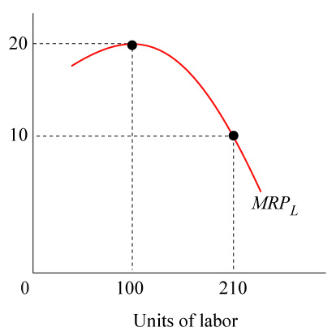
Refer to the figure. What explains the shape of this curve in a framework of competitive input and output markets?
a. Increasing marginal product of labor but decreasing output price.
b. Decreasing marginal product of labor along with lower output price.
c. Diminishing marginal returns and, consequently, decreasing marginal product of labor, but not output price.
d. Increasing marginal returns but decreasing output price.
e. Increasing output price, decreasing marginal product of labor, and diminishing returns.
<number> of 36

Slide 13
Refer to the figure. What explains the shape of this curve in a framework of competitive input and output markets?
a. Increasing marginal product of labor but decreasing output price.
b. Decreasing marginal product of labor along with lower output price.
c. Diminishing marginal returns and, consequently, decreasing marginal product of labor, but not output price.
d. Increasing marginal returns but decreasing output price.
e. Increasing output price, decreasing marginal product of labor, and diminishing returns.
<number> of 36

Slide 14
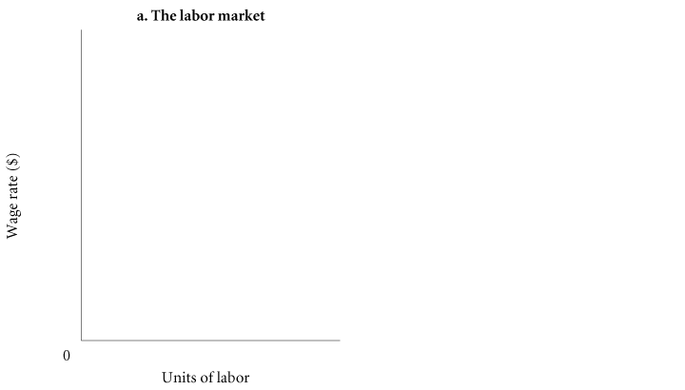


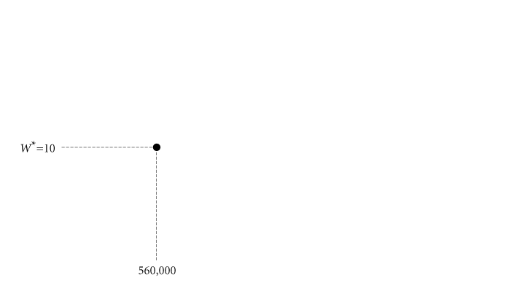
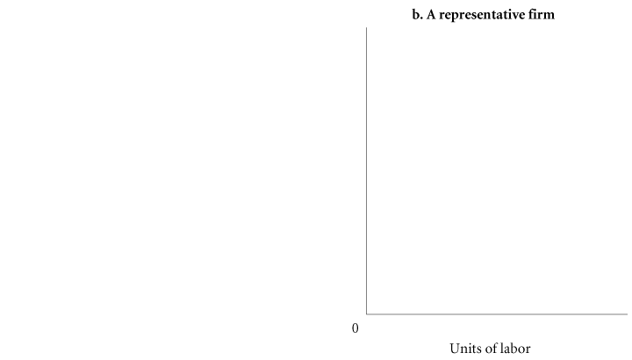
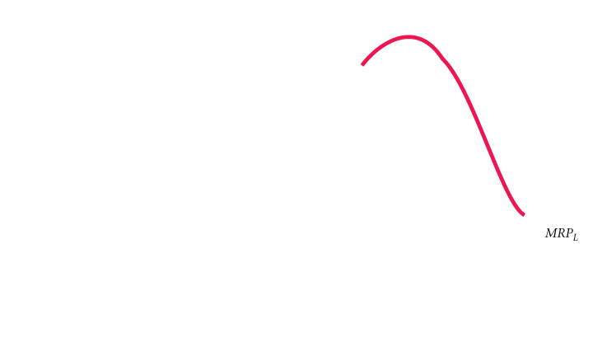

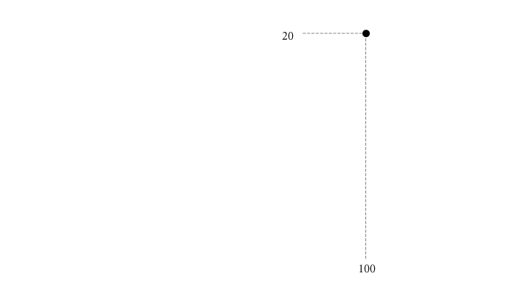
Labor Markets
A Firm Using Only One Variable Factor of Production: Labor
① FIGURE 10.2 Marginal Revenue Product and Factor Demand for a Firm Using One Variable Input (Labor)
A competitive firm using only one variable factor of production will use that factor as long as its marginal revenue product exceeds its unit cost. A perfectly competitive firm will hire labor as long as MRP_{L} is greater than the going wage, W*. The hypothetical firm will demand 210 units of labor.
<number> of 36

Slide 15
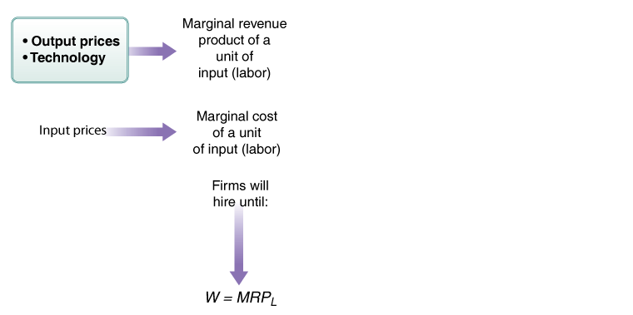
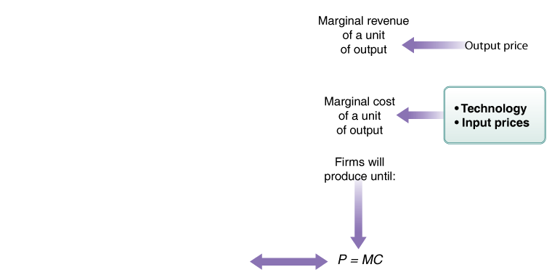
Labor Markets
A Firm Using Only One Variable Factor of Production: Labor
Comparing Marginal Revenue and Marginal Cost to Maximize Profits
① FIGURE 10.3 The Two Profit-Maximizing Conditions Are Simply Two Views of the Same Choice Process
<number> of 36

Slide 16
From the viewpoint of the business firm, the market wage is conceptually the same as:
a. The marginal cost of a unit of labor.
b. Marginal revenue.
c. Marginal revenue product.
d. Marginal product.
e. The firm’s demand for labor.
<number> of 36

Slide 17
From the viewpoint of the business firm, the market wage is conceptually the same as:
a. The marginal cost of a unit of labor.
b. Marginal revenue.
c. Marginal revenue product.
d. Marginal product.
e. The firm’s demand for labor.
<number> of 36

Slide 18

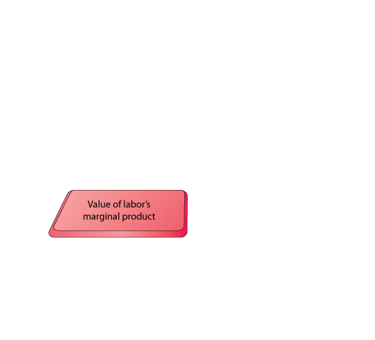
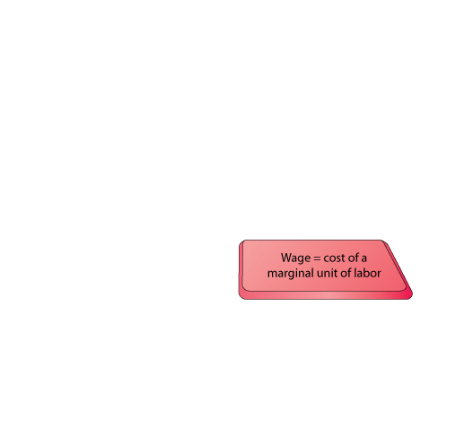
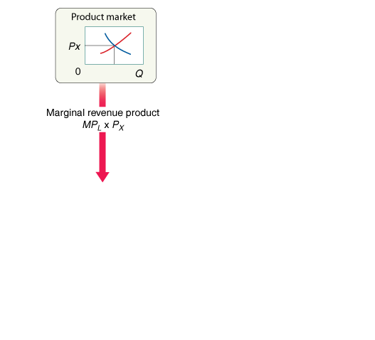
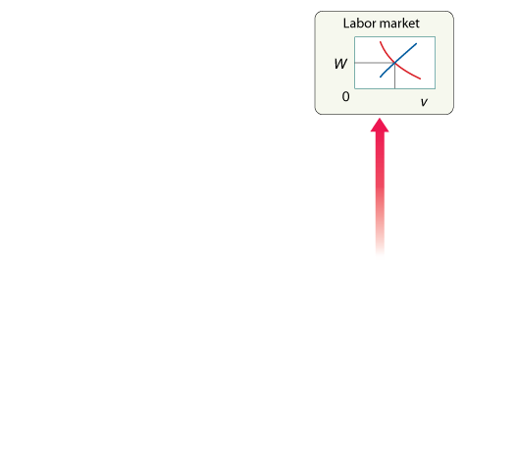
Labor Markets
A Firm Using Only One Variable Factor of Production: Labor
Comparing Marginal Revenue and Marginal Cost to Maximize Profits
④ FIGURE 10.4 The Trade-Off
Facing Firms
Firms weigh the cost of labor as reflected in wage rates against the value of labor’s marginal product. Assume that labor is the only variable factor of production. Then, if society values a good more than it costs firms to hire the workers to produce that good, the good will be produced.
<number> of 36

Slide 19
Labor Markets
A Firm Using Only One Variable Factor of Production: Labor
Deriving Input Demands
Calculating the marginal product of a variable input (labor) and marginal revenue product is essentially the same for both big corporations and small proprietorships.
Workers are hired because the entrepreneur expects that their current efforts will produce future revenues greater than their wage costs.
<number> of 36

Slide 20
Labor Markets
A Firm Employing Two Variable Factors of Production in the Short and Long Run
In firms employing just one variable factor of production, a change in the price of that factor affects only the demand for the factor itself. When more than one factor can vary, however, we must consider the impact of a change in one factor price on the demand for other factors as well.
<number> of 36

Slide 21
In order to maximize profit, a firm will hire workers up until:
P = MC.
MR = MC
c. W = MP_{L}
d. W = MRP_{L}
e. P = MC = SRAC = LRAC
<number> of 36

Slide 22
In order to maximize profit, a firm will hire workers up until:
P = MC.
MR = MC
c. W = MP_{L}
d. W = MRP_{L}
e. P = MC = SRAC = LRAC
<number> of 36

Slide 23
Labor Markets
A Firm Employing Two Variable Factors of Production in the Short and Long Run
Substitution and Output Effects of a Change in Factor Price
TABLE 10.2 Response of a Firm to an Increasing Wage Rate
Technology | Input Requirements Per Unit Of Output |  |  |  |  | Unit Cost if P_{L} = $1 P_{K} = $1 (P_{L} x L) + (P_{K} x K) | Unit Cost if P_{L} = $2 P_{K} = $1 (P_{L} x L) + (P_{K} x K)
 |  | K |  | L
A (capital intensive) |  | 10 |  | 5 |  | $15 | $20
B (labor intensive) |  | 3 |  | 10 |  | $13 | $23
<number> of 36

Slide 24
Labor Markets
A Firm Employing Two Variable Factors of Production in the Short and Long Run
Substitution and Output Effects of a Change in Factor Price
TABLE 10.3 The Substitution Effect of an Increase in Wages on a Firm Producing 100 Units of Output
 |  | To Produce 100 Units of Output
 | Total Capital Demanded |  |  | Total Labor Demanded |  |  | Total Variable Cost
When P_{L} = $1, P_{K} = $1, firm uses technology B | 300 |  |  |  | 1,000 |  | $1,300
When P_{L} = $2, P_{K} = $1, firm uses technology A | 1,000 |  |  |  | 500 |  | $2,000
<number> of 36

Slide 25
Labor Markets
A Firm Employing Two Variable Factors of Production in the Short and Long Run
Substitution and Output Effects of a Change in Factor Price
factor substitution effect The tendency of firms to substitute away from a factor whose price has risen and toward a factor whose price has fallen.
output effect of a factor price increase (decrease) When a firm decreases (increases) its output in response to a factor price increase (decrease), this decreases (increases) its demand for all factors.
<number> of 36

Slide 26

Labor Markets
A Firm Employing Two Variable Factors of Production in the Short and Long Run
Theater or the Movies?
Substitution and Output Effects of a Change in Factor Price
Roberts’ MRP depends not only on her talent but also on the way that talent is used by employers.
<number> of 36

Slide 27
Labor Markets
Many Labor Markets
If labor markets are competitive, the wages in those markets are determined by the interaction of supply and demand. As we have seen, firms will hire workers only as long as the value of their product exceeds the relevant market wage. This is true in all competitive labor markets.
<number> of 36

Slide 28
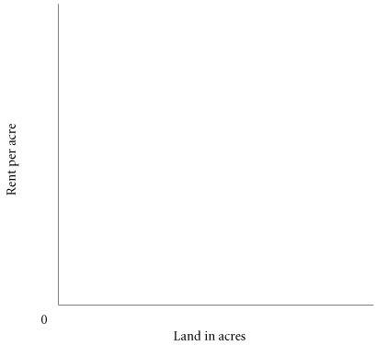


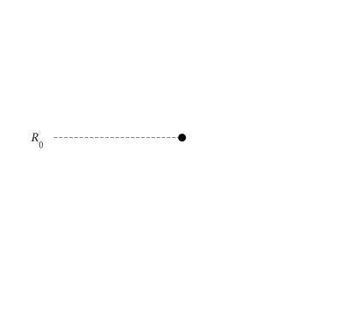
Land Markets
demand-determined price The price of a good that is in fixed supply; it is determined exclusively by what firms and households are willing to pay for the good.
pure rent The return to any factor of production that is in fixed supply.
③ FIGURE 10.5 The Rent on Land Is
Demand-Determined
Because land in general (and each parcel in particular) is in fixed supply, its price is demand-determined. Graphically, a fixed supply is represented by a vertical, perfectly inelastic supply curve. Rent, R₀, depends exclusively on demand—what people are willing to pay.
<number> of 36

Slide 29
What is the special feature that makes land different from capital and labor?
a. Land is in fixed supply, which means that its price is strictly determined by the amount available, or supply.
b. Land is in fixed supply, which means that its price is strictly determined by demand.
c. The supply of land is perfectly elastic.
d. The demand for land is perfectly inelastic.
e. Unlike capital and labor, both supply and demand for land determine the price of land.
<number> of 36

Slide 30
What is the special feature that makes land different from capital and labor?
a. Land is in fixed supply, which means that its price is strictly determined by the amount available, or supply.
b. Land is in fixed supply, which means that its price is strictly determined by demand.
c. The supply of land is perfectly elastic.
d. The demand for land is perfectly inelastic.
e. Unlike capital and labor, both supply and demand for land determine the price of land.
<number> of 36

Slide 31

Land Markets
Rent and the Value of Output Produced on Land
A firm will pay for and use land as long as the revenue earned from selling the product
produced on that land is sufficient to cover the price of the land. Stated in equation form, the firm will use land up to the point at which MRP_{A}= P_{A}, where A is land (acres).
Time Is Money
High-Speed Rail Give Short-Haul Air a Run for the Money in Europe, with More Flexible Travel, Greater Comfort, Lower Environmental Impact
Travel Industry News
<number> of 36

Slide 32
The Firm’s Profit-Maximizing Condition in Input Markets
Profit-maximizing condition for the perfectly competitive firm is
P_{L} = MRP_{L} = (MP_{L} x P_{X})
P_{K} = MRP_{K} = (MP_{K} x P_{X})
P_{A} = MRP_{A} = (MP_{A} x P_{X})
where L is labor, K is capital, A is land (acres), X is output, and P_{X} is the price of that output.
<number> of 36

Slide 33
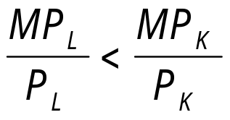
Consider the inequality below. Assuming diminishing returns to both capital and labor, how can the firm produce more output at a lower cost?
a. By increasing the amount of labor and decreasing the amount of capital used.
b. By increasing the amount of capital and decreasing the amount of labor used.
c. By increasing both labor and capital.
d. By decreasing both labor and capital.
e. By maintaining the same combination of inputs currently in use.
<number> of 36

Slide 34
Consider the inequality below. Assuming diminishing returns to both capital and labor, how can the firm produce more output at a lower cost?
a. By increasing the amount of labor and decreasing the amount of capital used.
b. By increasing the amount of capital and decreasing the amount of labor used.
c. By increasing both labor and capital.
d. By decreasing both labor and capital.
e. By maintaining the same combination of inputs currently in use.
<number> of 36

Slide 35
Input Demand Curves
Shifts in Factor Demand Curves
The Demand for Outputs
If product demand increases, product price will rise and marginal revenue product (factor demand) will increase—the MRP curve will shift to the right. If product demand declines, product price will fall and marginal revenue product (factor demand) will decrease—the MRP curve will shift to the left.
The Quantity of Complementary and Substitutable Inputs
The production and use of capital enhances the productivity of labor and normally increases the demand for labor and drives up wages.
<number> of 36

Slide 36
Input Demand Curves
Shifts in Factor Demand Curves
The Prices of Other Inputs
When a firm has a choice among alternative technologies, the choice it makes depends to some extent on relative input prices.
Technological Change
technological change The introduction of new methods of production or new products intended to increase the productivity of existing inputs or to raise marginal products.
<number> of 36

Slide 37
Resource Allocation and the Mix of Output in Competitive Markets
The Distribution of Income
marginal productivity theory of income distribution At equilibrium, all factors of production end up receiving rewards determined by their productivity as measured by marginal revenue product.
<number> of 36

Slide 38
REVIEW TERMS AND CONCEPTS
demand-determined price
derived demand
factor substitution effect
marginal product of labor (MP_{L})
marginal productivity theory of income distribution
marginal revenue product (MRP)
output effect of a factor price increase (decrease)
productivity of an input
pure rent
technological change
Equations:
MRP_{L} = MP_{L} x P_{X}
W*= MRP_{L}
<number> of 36

